Slide 1
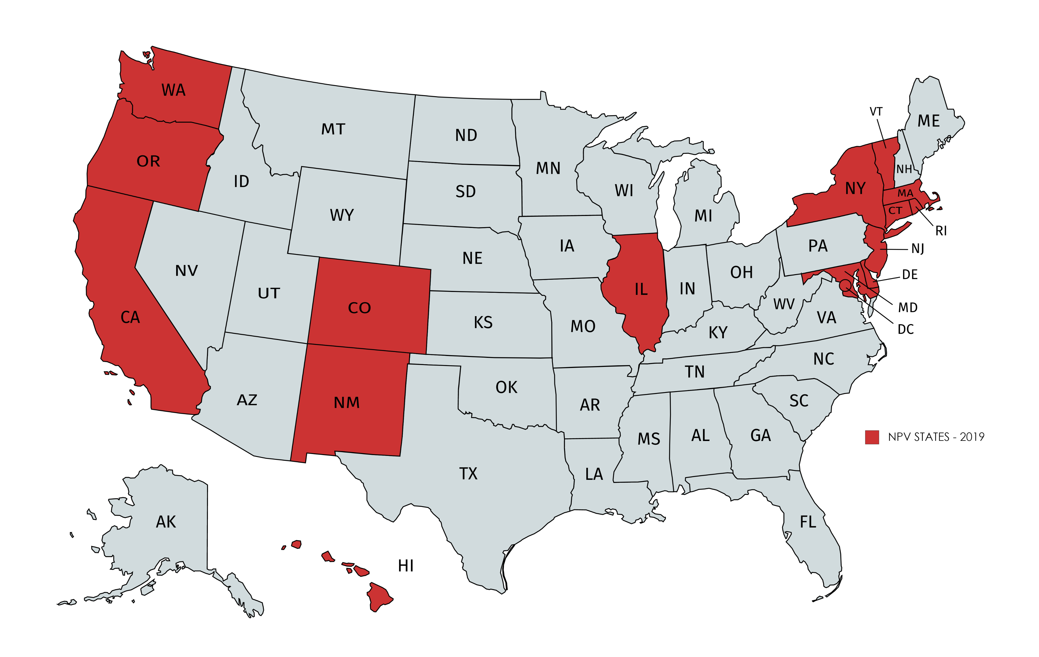
NATIONAL POPULAR VOTE > 15 STATES & DC

Slide 2
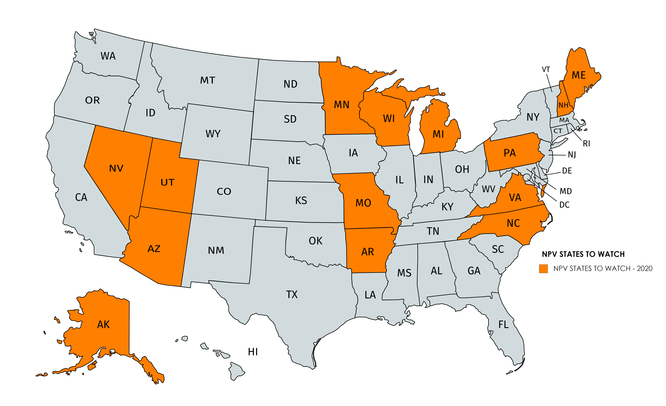
NPVIC TARGETED STATES IN 2020-2021 = 14
November 2020: Colorado NPV reversal referendum

Slide 3
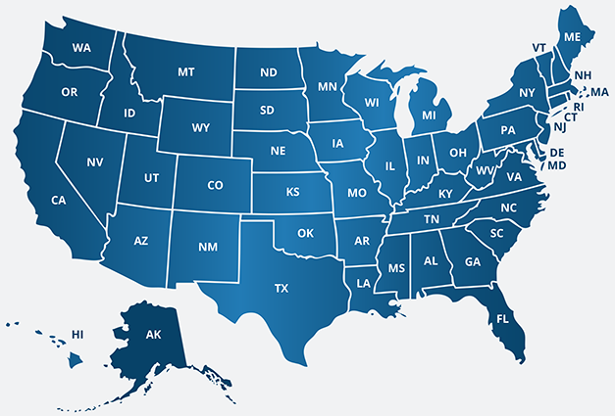
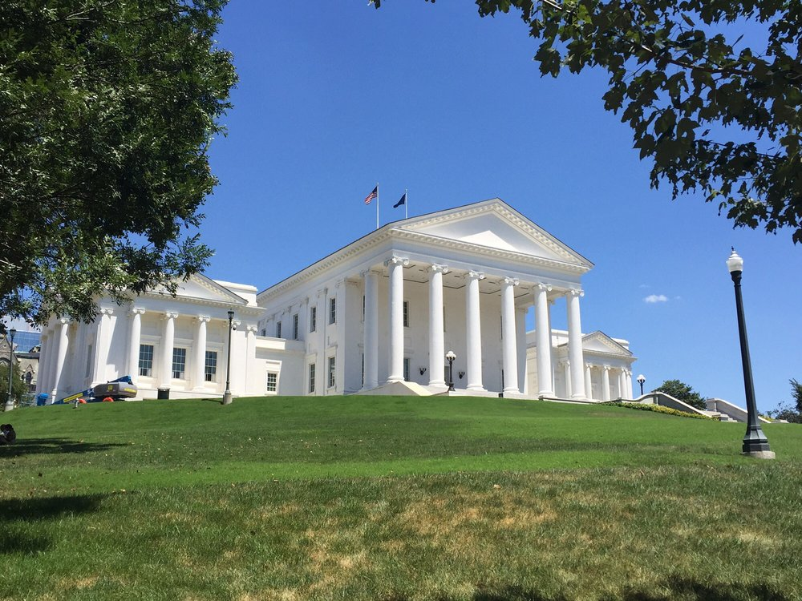
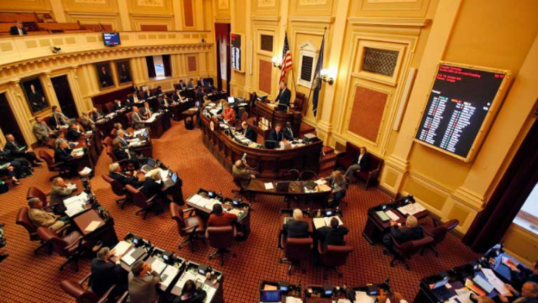
NPV & Virginia State Legislature 2020
HOUSE OF DELEGATES STATE SENATE HB-177 Passed 51-46 on 2/20 Stalled In Senate Committee on 2/20 The bill will be raised again in the 2021 Session.

Slide 4
Save Our States “Defending the Electoral College!”
Virginia Coalition For the Electoral College Members As of April 29, 2020: (6) Conservative Legislative Information Council of Virginia (CLIC-VA) (Carol Stopps) Constitution Party of Virginia (Paul Provance) Faith & Freedom Coalition of Virginia (Joshua Mayes) Family Foundation of Virginia (Steve Rossi) Save Our States – Coalition Secretariat (Michael Maibach + Sean Parnell) Virginia Institute for Public Policy (Lynn Taylor) Coalition Secretary: Michael Maibach, Save Our States - mcm@Maibach.us - 703-851-6811

Slide 5
Save Our States “Defending the Electoral College!”
VA SENATE P & E Comm. | DEM. PARTY (9) | MAIN CITY | HB-177 – NOTES:
Chair Creigh Deeds | D-25 | Charlottesville | Skeptical of NPV?
Sen. Janet Howell | D-12 | Reston | Committed NPV Supporter
Sen. Adam Ebbin | D-30 | Alexandria | Committed NPV Supporter
Sen. Lionell Spruill | D-5 | Chesapeake | NPV Opponent (Also EC Opponent)
Sen. Scott Surovell | D-36 | Mount Vernon | NPV Supporter
Sen. Monty Mason | D-1 | Williamsburg | Skeptical of NPV?
Sen. Jennifer McClellan | D-9 | Richmond | Committed NPV Supporter
Sen. Jennifer Boysko | D-33 | Herndon | Committed NPV Supporter
Sen. John Bell | D-13 | Broadlands | Likely NPV Supporter

Slide 6
Save Our States “Defending the Electoral College!”
VA SENATE P & E Comm. | REP. PARTY (6) | MAIN CITY | HB-177 – NOTES:
Sen. Jill Vogel | R-27 | Warrenton | Committed NPV Opponent
Sen. Bryce Reeves | R-17 | Fredericksburg | Committed NPV Opponent
Sen. Ben Chafin | R-38 | Lebanon | Committed NPV Opponent
Sen. Frank Ruff | R-15 | Clarksville | Committed NPV Opponent
Sen. Mark Peake | R-22 | Lynchburg | Committed NPV Opponent
Sen. Ryan McDougle | R-4 | Mechanicsville | Committed NPV Opponent

